Slide 1
Hacker Techniques, Tools, and Incident Handling
Chapter 4
Physical Security

Slide 2
Learning Objective
Identify security controls and defensive technologies.

Slide 3
Key Concepts
The role of physical security
Common physical controls
Physical access controls and biometrics
Avoiding threats to physical security
Defense in depth concepts

Slide 4
Basic Equipment Controls
Passwords
Password screen savers and session controls
Hard drive and mobile device encryption
Controls for printers, scanners, fax machines, and Voice over Internet Protocol (VoIP) telephone systems

Slide 5
Hard Drive and Mobile Device Encryption
Encryption
Use on files, folders, entire hard disk or device’s available memory
Full disk protection
Apply encryption to entire disk
Software
Use Pretty Good Privacy (PGP), TrueCrypt, and BitLocker to lock files and folders
Bitlocker and Encrypting File System (EFS)
May come as part of operating system

Slide 6
Hard Drive and Mobile Device Encryption (Cont.)
Sanitization
Drive Wiping
Zeroization
Degaussing
Notes:
Drive wiping — Overwriting all information on the drive
Zeroization — Associated with cryptographic processes; data is overwritten with zeros
Degaussing — Permanently destroys the contents of a hard drive or magnetic media; a magnet penetrates the media and reverses the polarity of the magnetic particles on the tape or hard disk platters

Slide 7
Fax Machines and Printers
Security issues
Not designed with security in mind
Data transmission is unprotected
Documents sit in tray waiting for owner to retrieve them
Documents stored in memory and can be reprinted later
Can easily review device history and see what was sent, received, or printed

Slide 8
Voice over IP (VoIP)
Allows telephone calls over computer networks and the Internet
Voice signals may be transmitted as data packets
Is susceptible to the same attacks that affect regular data transmission
Phone calls can be intercepted and captured

Slide 9
Physical Area Controls
Perimeter intrusion detection and assessment system (PIDAS)
Fence
Gate
Bollard
Notes:
Fencing — A visible, physical and psychological deterrent to unwanted access
Perimeter Intrusion Detection and Assessment System (PIDAS) — A special fencing that has sensors to detect intruders
Gates — A chokepoint through which all traffic must enter or exit; gates range from ornamental to those designed for enhanced protective measures
Bollards — Designed to prevent entry to designated areas by vehicles

Slide 10
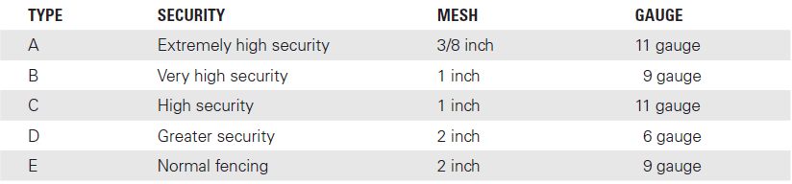
Fences

Slide 11
Facility Controls
Guards and dogs
Doors, mantraps, and turnstiles
Walls, ceilings, and floors
Windows and construction

Slide 12
Doors, Mantraps, and Turnstiles
Doors
Industrial doors
Vehicle-access doors
Bulletproof doors
Vault doors
Mantraps
Replaces a single door with a phone booth-sized space with a door on each side
Only one person at a time may enter and only one door at a time can be opened

Slide 13
Doors, Mantraps, and Turnstiles (Cont.)
Turnstiles
Used to slow the flow of traffic and ensure individuals are screened and authenticated prior to entering an area
Commonly used at sporting events, subways, and amusement parks

Slide 14
Walls, Ceilings, and Floors
Reinforced walls may deter attacker from entering other than through defined doors
Avoid false walls
Walls should run from slab to roof
Use solid versus hollow wall construction
Ceilings should meet all weight-bearing load and fire specifications
Raised floors should be grounded and nonconducting; walls should extend below the false floor

Slide 15
Windows
Standard
Polycarbonate acrylic
Wire reinforced
Security film
Laminated
Solar film
Notes:
Standard — The lowest level of protection. They’re cheap and easily shattered and destroyed.
Polycarbonate acrylic — Much stronger than standard glass, this type of plastic offers superior protection.
Wire reinforced — Adds shatterproof protection and makes it harder for an intruder to break and access.
Laminated — Similar to what is used in an automobile. By adding a laminate between layers of glass, the strength of the glass is increased, and shatter potential is decreased.
Solar film — Provides a moderate level of security and decreases shatter potential.
Security film — Used to increase the strength of the glass in case of breakage or explosion.

Slide 16
Guards and Dogs
Guards
Financial cost
Conduct criminal background checks before hiring
Monitor closed-circuit television (CCTV), premises control equipment, intrusion detection systems and other computerized surveillance devices
Dogs
Provide perimeter security
Usually restricted to exterior premises control

Slide 17
Construction
Construction design and functionality
Physical security concerns
Redundancy measures
Vandalism
Natural or environmental concerns
Proximity to hazards
Crime rate
Relationship to emergency services

Slide 18
Personal Safety Controls
Lighting
CCTV
Alarms

Slide 19
Lighting
Continuous
Fixed lighting arranged to flood area with light
Standby
Can duplicate all of the previous lights
Randomly turned on to create impression of activity
Movable
Manually operated movable searchlights
Emergency
Must have alternative power source

Slide 20
Alarms and Intrusion Detection
Provides alerts for fire, carbon monoxide, and potential intrusions
May have audible and visual alerts
Should have capability to contact remote resources
False alarms can be an issue

Slide 21
Closed-Circuit TV (CCTV)/Remote Monitoring
Usually works in conjunction with guards
Provide ability to see what is occurring in different locations
In placing surveillance devices, consider factors such as
Lighting
Lens types
Depth of field
Focal length

Slide 22
Physical Access Controls
Locks
Tokens
Biometrics

Slide 23
Locks
Mechanical
Cipher
Warded and pin and tumbler
Smart and programmable

Slide 24
Lock Picking
Tension wrenches
Similar to small, angled flathead screwdrivers
Picks
Similar to dentist picks; small, angled and pointed

Slide 25
Tokens and Biometrics
Tokens:
Active electronic: Access card has ability to transmit electronic data
Electronic circuit: Access card has an electronic circuit embedded.
Magnetic stripe: Access card has a stripe of magnetic material
Contactless cards: Access card communicates with the card reader electronically

Slide 26
Tokens and Biometrics (Cont.): Biometric Systems
Finger scan systems
Hand geometry systems
Palm scan systems
Retina pattern systems
Iris recognition
Voice recognition
Keyboard dynamics

Slide 27
Avoiding Common Threats to Physical Security
Natural/human/technical threats
Physical keystroke loggers
Sniffers
Wireless interception and rogue access points

Slide 28
Natural, Human, and Technical Threats
Theft
Vandalism
Destruction
Terrorism
Accidental

Slide 29
Physical Keystroke Loggers and Sniffers
Keystroke loggers
Physical devices used to record everything a person types on the keyboard
Sniffers
Passive sniffing relies on “promiscuous mode” in network cards
Keyboard cable, inside keyboards, or software on system
Active sniffing relies on injecting packets into the network

Slide 30
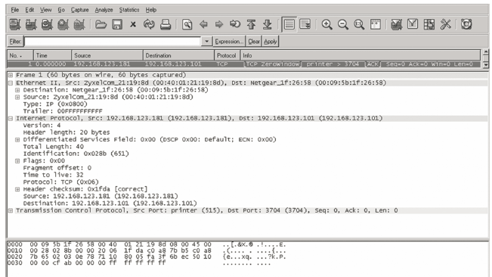
Wireshark

Slide 31
Wireless Interception and Rogue Access Points
Bluejacking
Eavesdropping
Open authentication
Rogue access points
Denial of service
False access points

Slide 32
Defense in Depth
Based on concept of layering more than one control
Controls can be physical, administrative, or technical in design

Slide 33
Defense in Depth: Physical Facility
Strive for minimum of three layers
First layer
Building perimeter
Second layer
Building exterior: roof, walls, floor, doors, and ceiling
Third layer
Interior controls: locks, safes, containers, cabinets, interior lighting

Slide 34
Summary
The role of physical security
Common physical controls
Physical access controls and biometrics
Avoiding threats to physical security
Defense in depth concepts

